Slide 1
Game Site
Cayce Harwood – CIT190

Slide 2
Target Audience
People interested in strategy or reaction-based games
Interactive Features
Main menu “shooting gallery”
Mouseover descriptions of each game

Slide 3
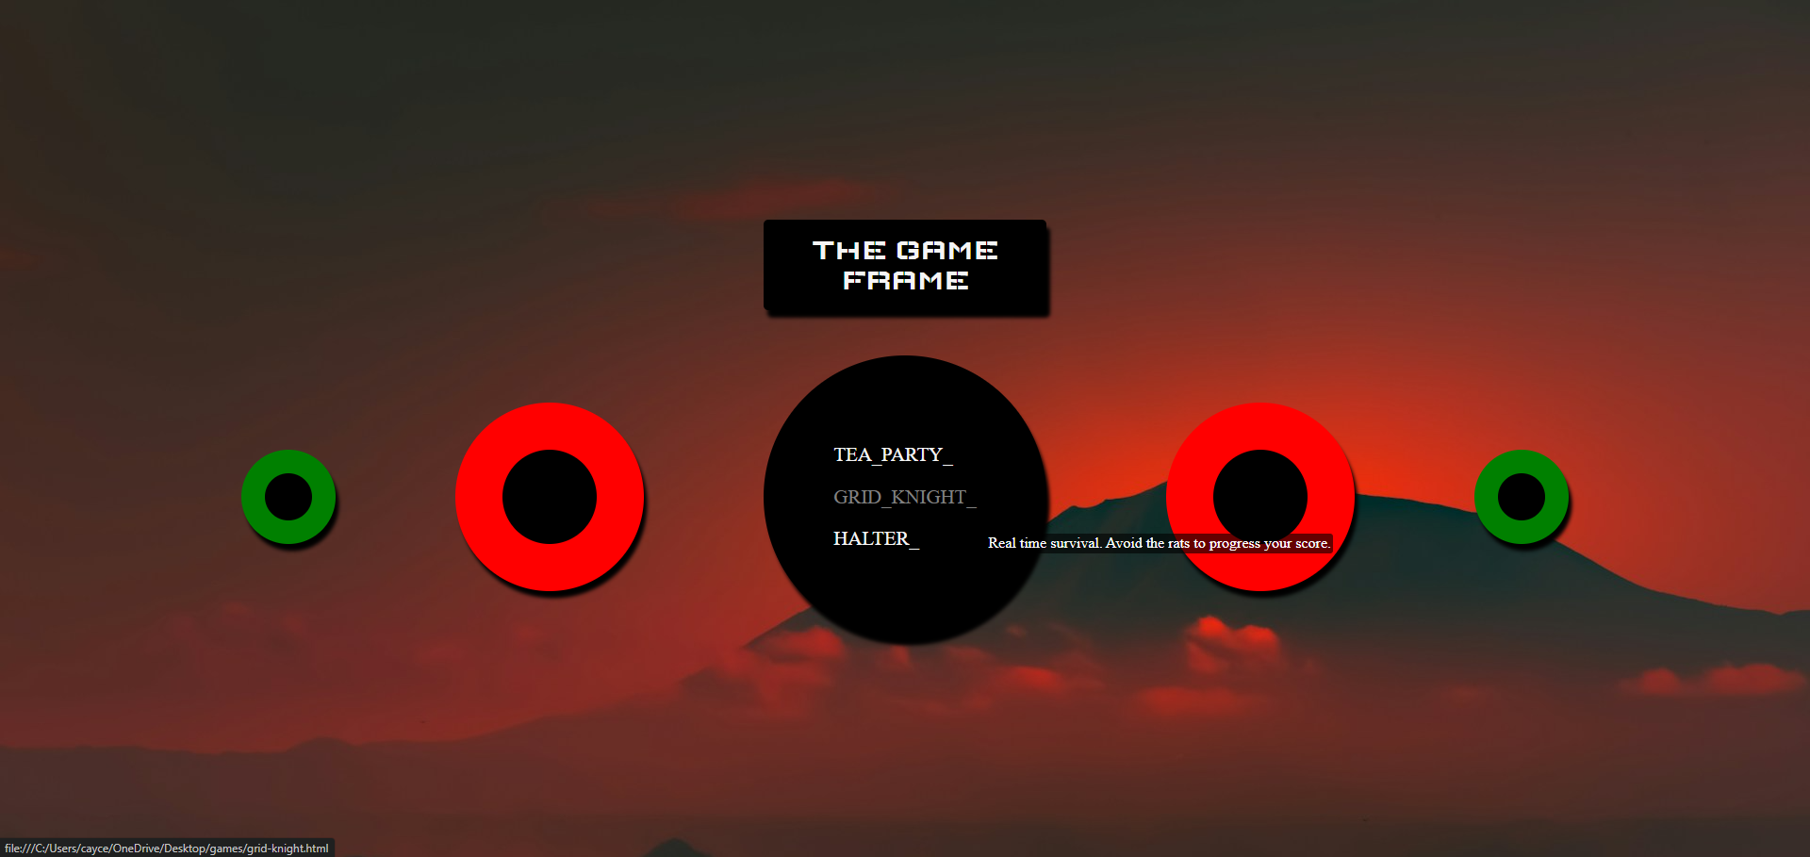
The surrounding circles are mapped with code to change color and play a sound quip when clicked

Slide 4
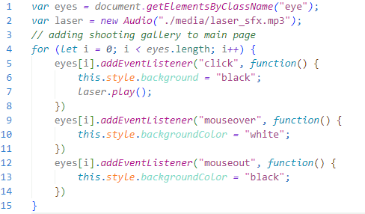
“target” code
Defines an array object with every element in the “eye” class
Imports laser SFX
Iterates through array object, adding necessary styles; plays audio on click

Slide 5
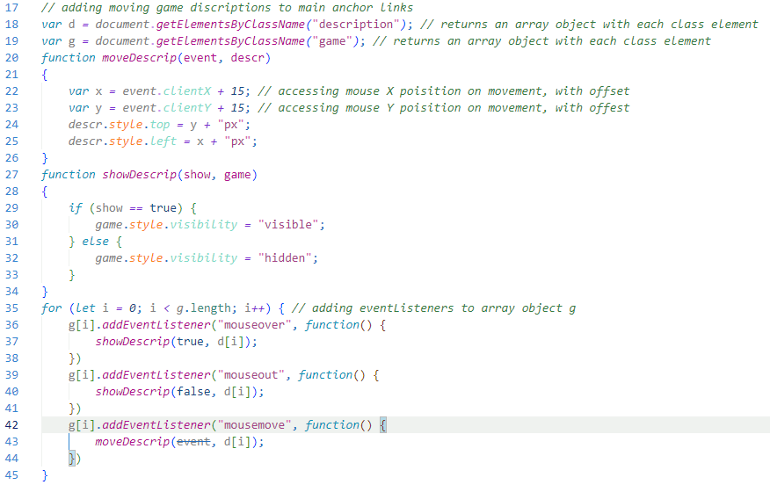
Mouseover description code
Creates object arrays accessing game descriptions and game links (descriptions are inherently hidden)
Creates a function to find mouse position, then alter description pos. in real time
Creates function to alter description visibility
Loops through array objects, adding mouse event listeners

Slide 6
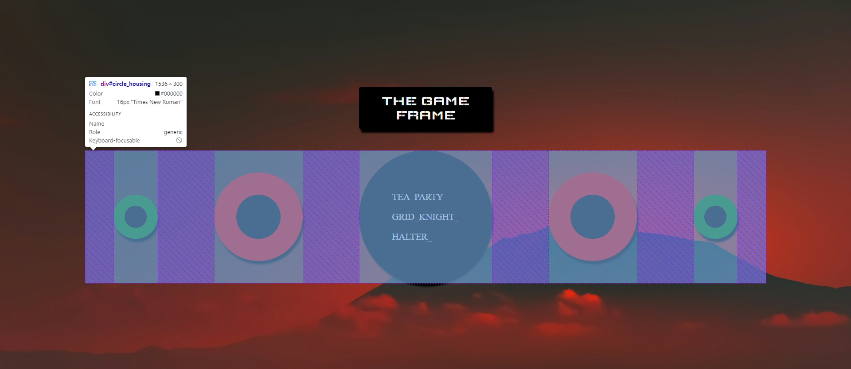
Use of flex containers for responsive design
Circular elements will narrow as viewport size shrinks. At smaller viewport sizes, elements may begin to appear elliptical…

Slide 7
design
Color scheme relies on red and black, with a complementary green to balance
Mountain background gives elements a sense of profound depth
Box shadows give depth to elements, making them appear close
Elements are circular to appear organic/naturally occurring
Text remains plain to appeal to a timeless design
Elements are spaced evenly to appeal to symmetry

Slide 8
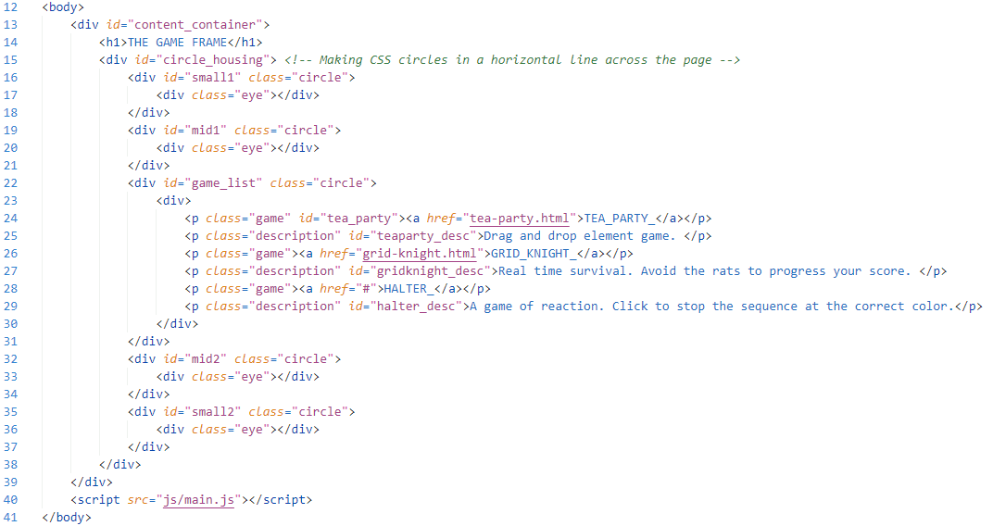
HTML CODE Solution

Slide 9
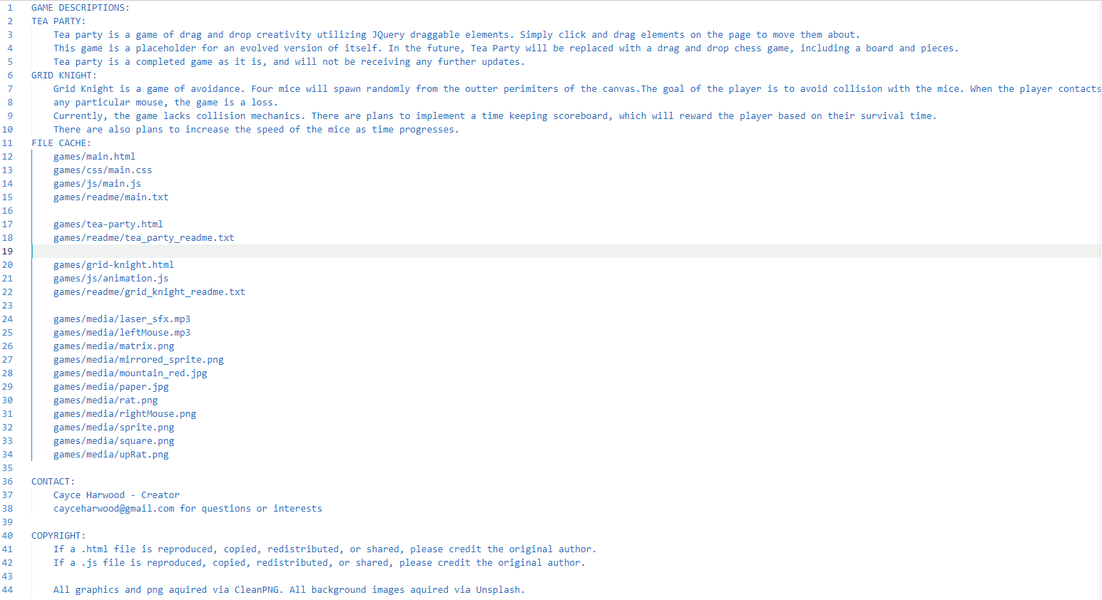
README.TXT​

Slide 10
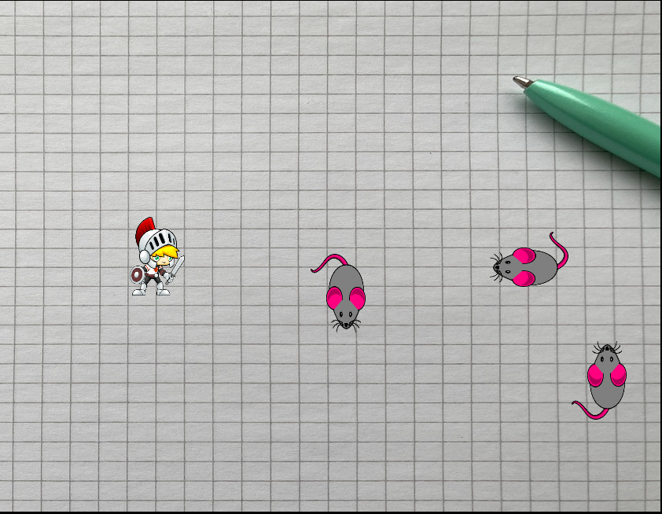
GRID knight – A game
A game where players dodge randomly positioned rats in real time to progress their score.
Created with simplicity for an audience of any age.

Slide 11
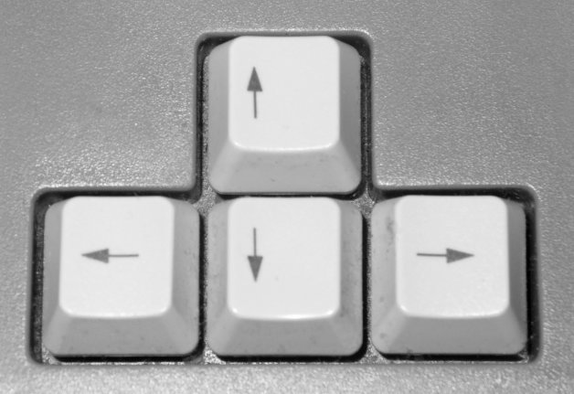
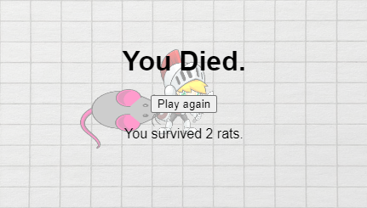
Grid knight information
Grid knight is played using the arrow keys on a standard keyboard.
Grid Knight has one form of interaction in the way of collision between player and enemy.

Slide 12



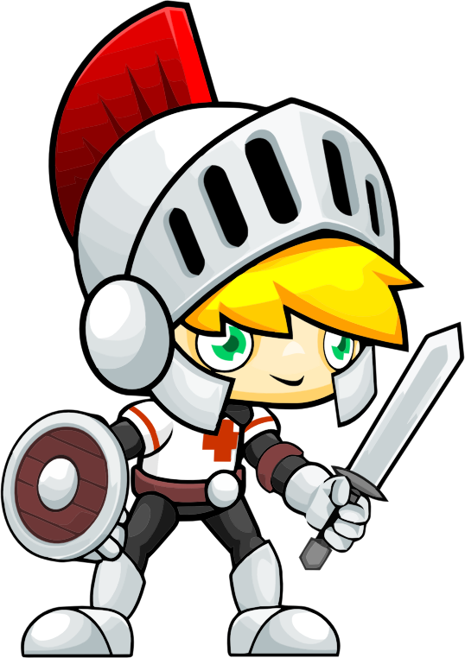
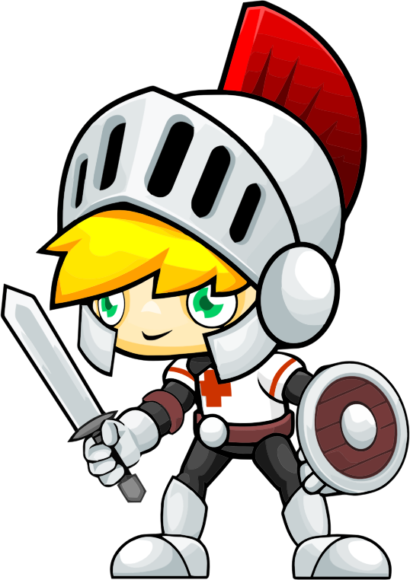

Grid knight design
Grid Knight’s design was influenced by the free assets available at the time. There is no overarching theme to Grid Knight, leaving it open to interpretation. Why is an armored player avoiding man sized-rats?
Grid Knight was an experiment in object-oriented programming, perhaps leading to the choice of a grid background, and thus the name of the game.

Slide 13
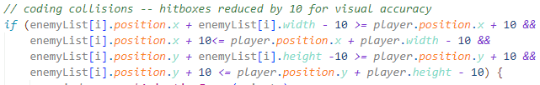
Grid knight difficulties
The greatest challenge in Grid Knight? Coding object collision from all directions.
Fortunately, the solution is achieved by comparing player x and y values to enemy x and y values in only four lines of code. There are plenty of resources online addressing collision mechanics, which were great assets to development.

Slide 14
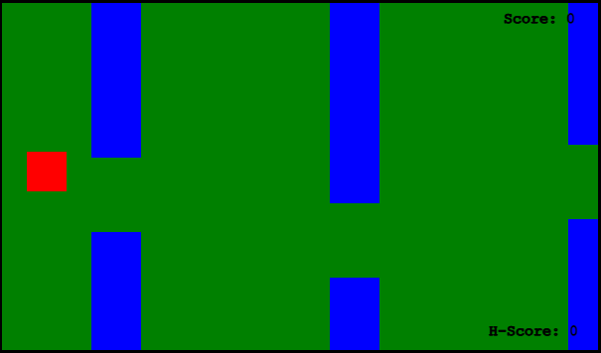
Flyby progress
Flyby is a finished game
Flyby uses object-oriented programming to achieve its goal
Flyby currently has one major issue – which has been fixed since release

Slide 15
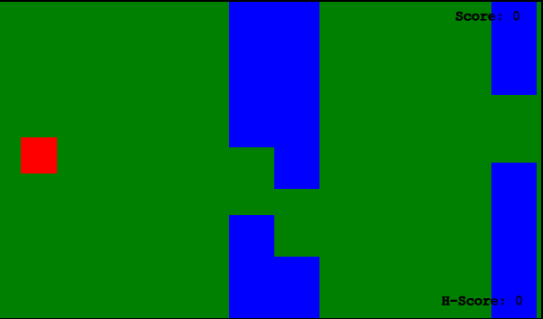
Flyby bugs/glitches
Flyby utilizes both an animation frame as well as an interval timer to spawn “tubes” into its canvas. Because both loops run simultaneously, Flyby will occasionally spawn tubes at odd intervals, though only on game start.
How should the issue be addressed? Perhaps adding a grace period to spawning tubes on game start?
SOLUTION: instead of utilizing an interval outside of the game scope, “tubes” now spawn based on position, within the game scope

Slide 16
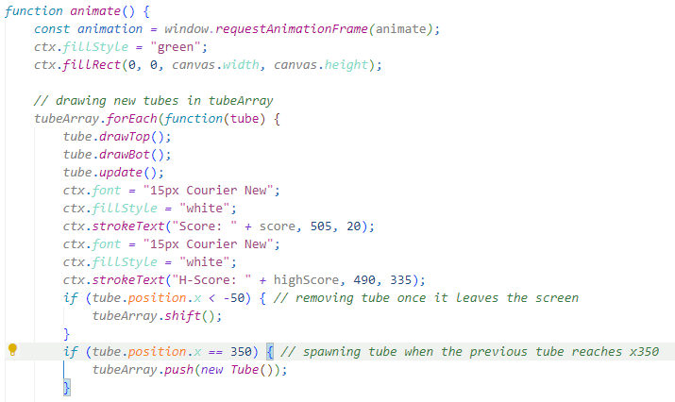
Flyby bugs/glitches solution
Utilizes position-based spawns vs. time-based spawns
game() no longer draws from a function outside of its scope

Slide 17
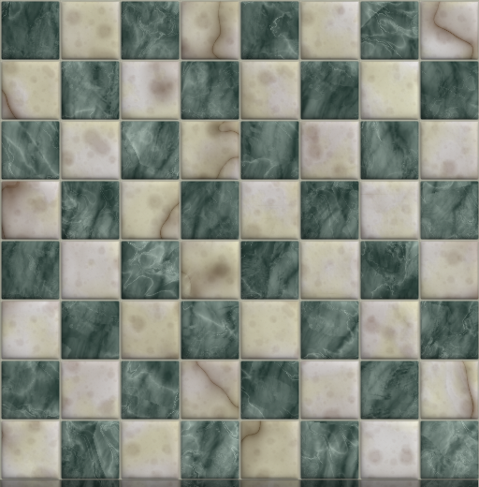



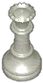








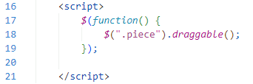
Jquery chess
Draggable pieces
Pieces downloaded as PNGs, cut out using LunaPic
Game is 3D
Design scheme is marble
Using a single, three-line function to operate.

Slide 18
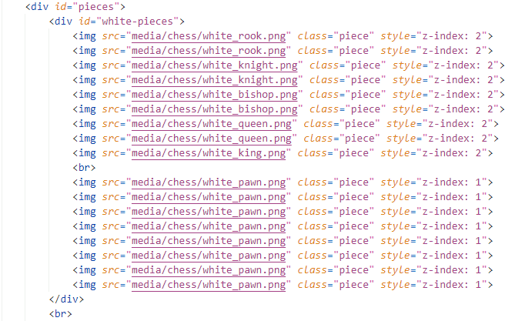
Jquery chess HTML
Utilizes a dump of pieces. One line of major/minor pieces, followed by another line of pawns.
The same is done for black’s pieces.
Pieces utilize a z-index to appear at different depths during play

Slide 19
Effective delivery techniques​
Voice modulation is a powerful tool in public speaking. It involves varying pitch, tone, and volume to convey emotion, emphasize points, and maintain interest:
Pitch variation​
Tone inflection​
Volume control
Effective body language enhances your message, making it more impactful and memorable:
Meaningful eye contact
Purposeful gestures
Maintain good posture
Control your expressions

Slide 20
Navigating Q&A sessions
Know your material in advance​
Anticipate common questions​
Rehearse your responses
Maintaining composure during the Q&A session is essential for projecting confidence and authority. Consider the following tips for staying composed:​
Stay calm​
Actively listen​
Pause and reflect​
Maintain eye contact

Slide 21
THANK YOU
Brita Tamm​
502-555-0152​
brita@firstupconsultants.com​
www.firstupconsultants.com

